Slide 1

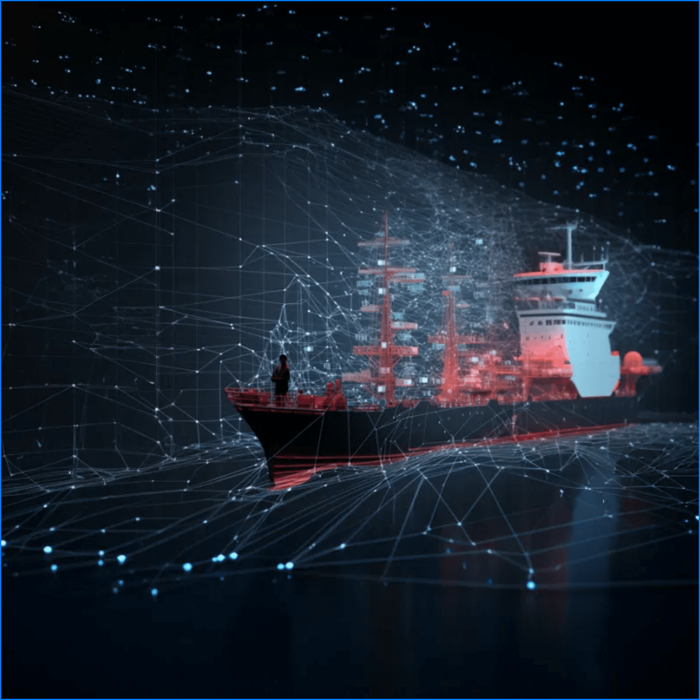
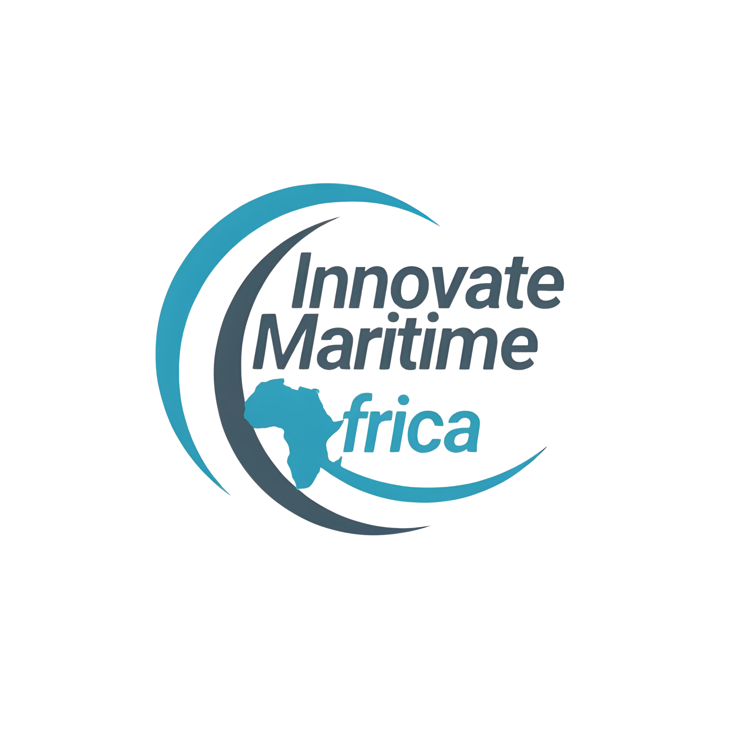
Maritime Data
Analytics Course
Practical Data Skills for Modern
Maritime Operations
Delivered by
Innovate Maritime Africa (IMA) /
Dee Marine Analytics

Slide 2

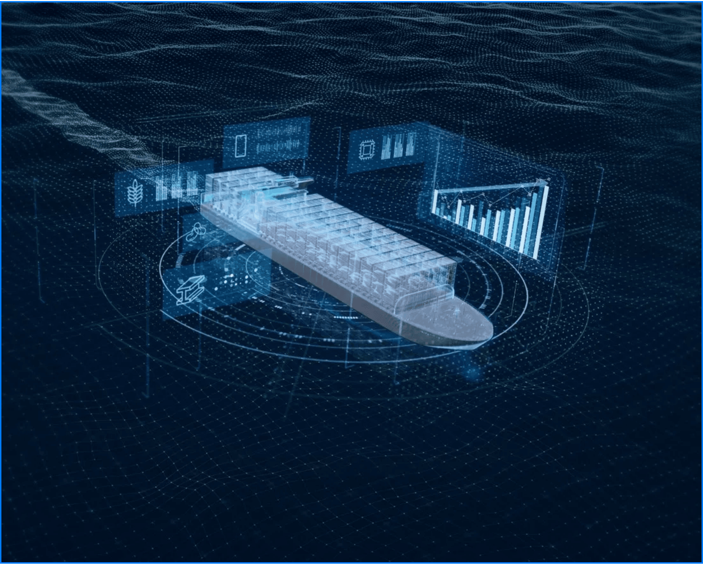




Course Overview
Bridging Maritime Expertise with Data Science
Industry-focused training program designed for maritime professionals.
Equips participants with practical skills to improve operational efficiency and safety.
Translates raw operational data into actionable insights for modern digital maritime operations.
Highly practical approach using real-world maritime datasets from ports and vessels.

Slide 3








Who This Course Is For
Designed for Professionals Across the Maritime Ecosystem
Port & Terminal Operations Staff
Marine Engineers & Technical Managers
Maritime Regulators & Inspectors
Operations, Safety & Compliance Teams
Transport, Logistics & Supply Chain Professionals
Maritime Professionals Seeking Digital Upskilling
No advanced programming background is required for this course.

Slide 4





Learning Outcomes
Mastering Data for Better Maritime Decisions
Collect, clean, and structure maritime operational data effectively.
Analyse performance trends using practical, industry-standard tools.
Develop interactive dashboards for operational and management reporting.
Support data-driven decision-making across diverse maritime functions.
Improve overall efficiency, transparency, and reporting accuracy.

Slide 5



Curriculum: Foundation & Management
Understanding the Digital Maritime Landscape
Module 01
Module 02
Introduction to Maritime Data & Digitalisation
Data Collection & Management
Digital transformation in the maritime sector
Sources of maritime data (ports, vessels)
Types of maritime operational data
Data quality, consistency, and governance
Data-driven decision-making in ports
Structuring data for analysis

Slide 6

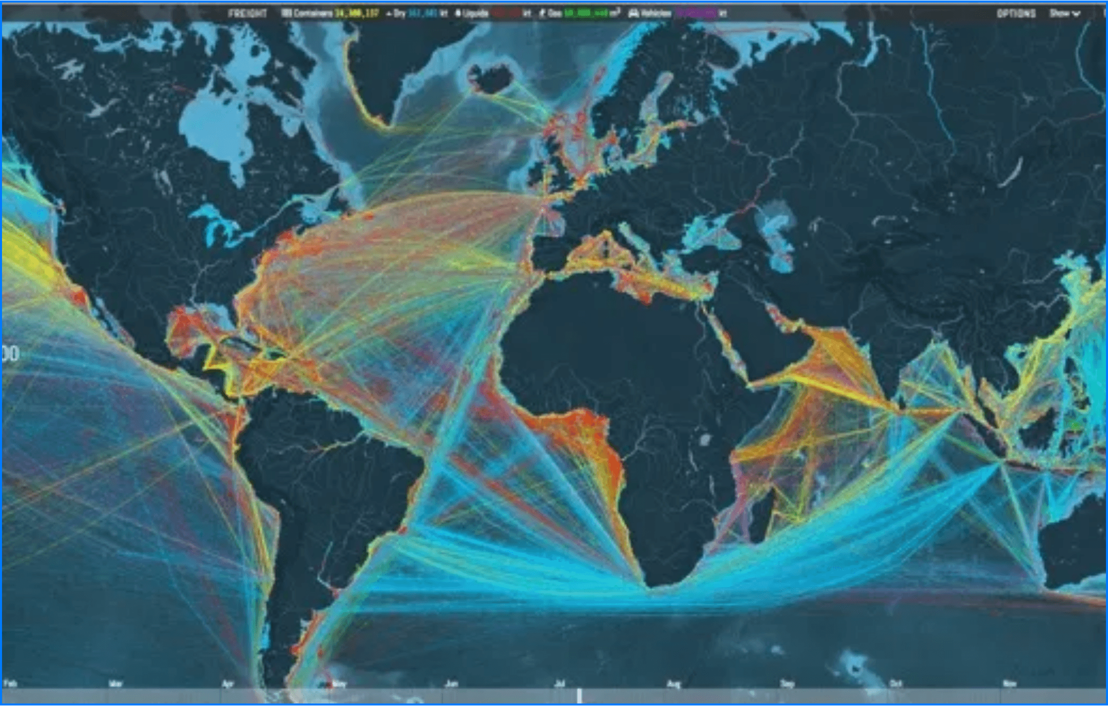





Curriculum: Analysis & Visualization
From Raw Data to Visual Insights
Module 3: Data Cleaning & Analysis (Excel)
Cleaning and preparing maritime datasets
Descriptive analysis for operational insights
Defining Key Performance Indicators (KPIs)
Module 4: Data Visualisation (Power BI)
Introduction to Power BI for maritime use cases
Building interactive dashboards
Visualizing global maritime traffic and operational trends.
Performance monitoring and reporting

Slide 7

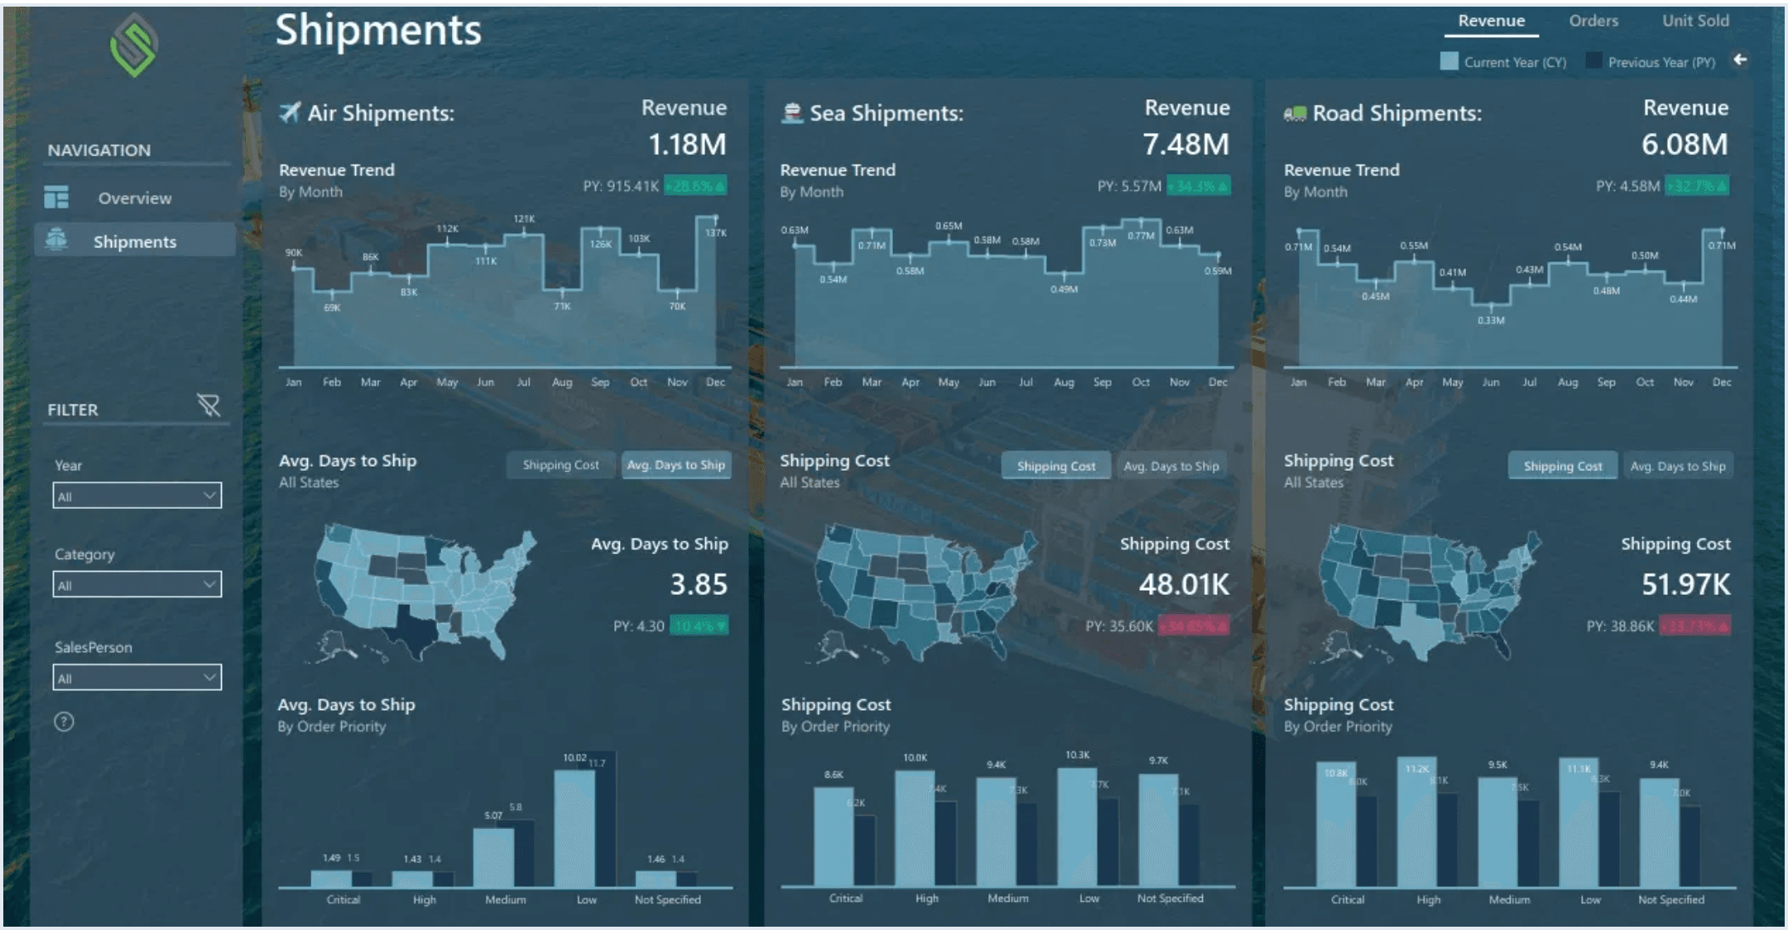
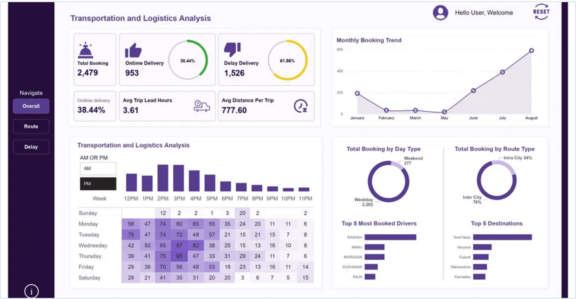
Curriculum: Metrics & Applications
Applying Analytics to Real-World Operations
Module 5: Maritime Performance Metrics & KPIs
Module 6: Case Studies & Practical Applications
Operational efficiency and safety indicators.
Port operations and vessel performance insights.
Compliance and environmental monitoring.
Regulatory and compliance reporting use cases.
Data-driven management decision support.
Real-world maritime dataset exercises.

Slide 8





Delivery Format & Commitment
Flexible and Practical Learning Experience
Learning Format
Time Commitment
Online, live instructor-led sessions
Interactive and practical approach
Course Duration
8 Weeks
Real-world maritime datasets
Session Length
2 Hours
Q&A and discussion opportunities
Total Learning Time
16 HOURS

Slide 9






Organisational Benefits
Driving Institutional Excellence through Digital Upskilling
Data-Driven Decisions
Reporting Accuracy
Process Optimization
Enhancing operational decision-making through evidence-based insights.
Improving efficiency and precision in operational and management reporting.
Reducing reliance on manual and fragmented reporting processes.
Digital Transformation
Future-Ready Staff
ESG & Sustainability
Supporting innovation initiatives and modernizing maritime operations.
Upskilling the workforce with essential analytical capabilities for the digital age.
Aligning with global maritime digitalisation and sustainability goals.

Slide 10







Certification & Group Training
Validated Skills for Professional Growth
Professional Certification
Corporate Solutions
Certificate of Completion
Group & Corporate Training
Issued by Innovate Maritime Africa (IMA).
Tailored programs for specific operational needs.
Recognizes practical proficiency in maritime data analytics.
Cohort-based training ideal for departments.
Group enrolment options and corporate discounts.
Validates your commitment to digital transformation.

Slide 11


Start Your Digital
Transformation Journey Today
For course details, group enrolment, or organisational training enquiries:
innovatemaritimeafrica.com/ima-maritime-data-analytics-course/
Delivered by
Innovate Maritime Africa (IMA) / Dee Marine Analytics

